Slide 1
Computer Graphics
Prof. Pushpmala V. Shinde

Slide 2
Scan conversion:
Line drawing algorithms: Digital Differential Analyzer (DDA), Bresenham.
Circle drawing algorithms: DDA, Bresenham, and Midpoint.

Slide 3
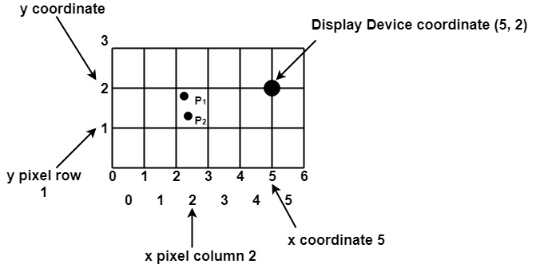
Scan Conversion Definition
It is a process of representing graphics objects a collection of pixels.
The graphics objects are continuous. The pixels used are discrete. Each pixel can have either on or off state.
Advantage of developing algorithms for scan conversion :
* Algorithms can generate graphics objects at a faster rate.
* Using algorithms memory can be used efficiently.
* Algorithms can develop a higher level of graphical objects.
Scan Converting a Point
Each pixel on the graphics display does not represent a mathematical point. Instead, it means a region which theoretically can contain an infinite number of points.
Example: Display coordinates points
as shown in fig would
both be represented by pixel (2, 1).
In general, a point p (x, y) is represented
by the integer part of x & the integer part
of y that is pixels [(INT (x), INT (y).

Slide 4
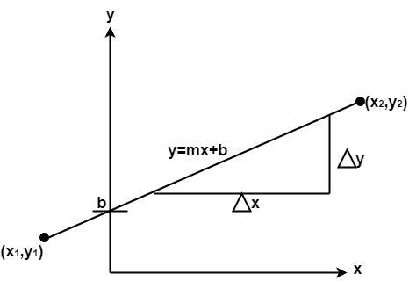
Scan Converting a Straight Line :
A straight line may be defined by two endpoints & an equation. In fig the two endpoints are described by (x1,y1) and (x2,y2). The equation of the line is used to determine the x, y coordinates of all the points that lie between these two endpoints.
Using the equation of a straight line, y = mx + b
where m = & b = the y interrupt,
we can find values of y by incrementing x
from x =x1, to x = x2.
By scan-converting these
calculated x, y values, we represent the
line as a sequence of pixels.

Slide 5
Properties of Good Line Drawing Algorithm:
Line should appear Straight
Lines should terminate accurately
Lines should have constant density
Line density should be independent of line length and angle
Line should be drawn rapidly
Line Drawing Algorithm:
DDA (Digital Differential Analyzer )
Bresenham's Algorithm

Slide 6
Line Drawing Algorithm: 1. DDA (Digital Differential Analyzer ) :
DDA stands for Digital Differential Analyzer. It is an incremental method of scan conversion of line. In this method calculation is performed at each step but by using results of previous steps.
DDA Algorithm:
Step1: Start Algorithm
Step2: Declare x1,y1,x2,y2,dx,dy,x,y as integer variables.
Step3: Enter value of x1,y1,x2,y2.
Step4: Calculate dx = x2-x1
Step5: Calculate dy = y2-y1
Step6: If ABS (dx) > ABS (dy) Then step = abs (dx) Else
Step7: x inc=dx /step y inc=dy /step assign x = x1 assign y = y1
Step8: Set pixel (x, y)
Step9: x = x + xinc y = y + yinc Set pixels (Round (x), Round (y))
Step10: Repeat step 9 until x = x2
Step11: End Algorithm

Slide 7
Eample DDA:
Plot the Line between the points (5,4) & (12,7) using DDA line drawing algo.

Slide 8
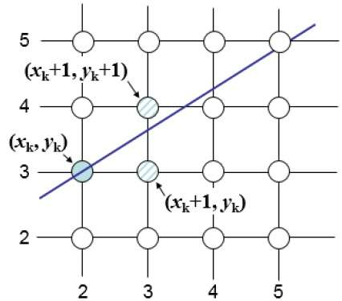
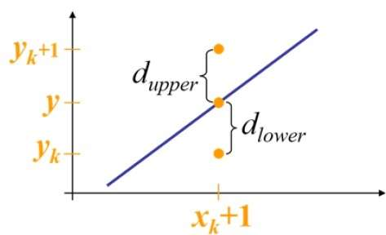
Bresenham’s Line Generation Algo. :
The Bresenham algorithm is another incremental scan conversion algorithm.
The big advantage of this algorithm is that, it uses only integer calculations. Moving across the x axis in unit intervals and at each step choose between two different y coordinates.
For example, as shown in the following illustration, from position 2,3 you need to choose between 3,3 and 3,4. You would like the point that is closer to the original line.
A decision parameter Pk for the kth step along a line.

Slide 9
Bresenham’s Line Generation Algo. :
Step 1 − Input the two end-points of line, storing the left end-point in (x0,y0).
Step 2 − Plot the point (x0,y0).
Step 3 − Calculate the constants dx, dy, ,2dx,2dy, and 2dy–2dx and get the first value for the decision parameter as −
P0=2dy−dx
Step 4 − At each Xk along the line, starting at k = 0, perform the following test −
If pk < 0, the next point to plot is (xk+1,yk) and
pk+1=pk+2dy
Otherwise,
point to plot is (Xk+1,Yk+1) and pk+1=pk+2dy−2dx
Step 5 − Repeat Step 4 dx-1 times.

Slide 10
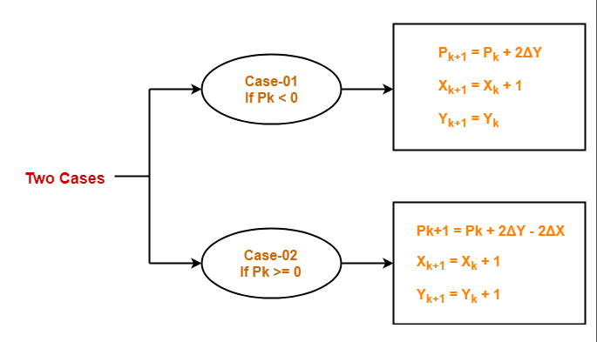

Slide 11
Calculate the points between the starting coordinates (9, 18) and ending coordinates (14, 22).
Given-
Starting coordinates = (X₀, Y₀) = (9, 18)
Ending coordinates = (X_{n}, Y_{n}) = (14, 22)
Step-01:
Calculate ΔX and ΔY from the given input.
ΔX = X_{n} – X₀ = 14 – 9 = 5
ΔY =Y_{n} – Y₀ = 22 – 18 = 4

Slide 12
Step-02:
Calculate the decision parameter.
P_{k}
= 2ΔY – ΔX
= 2 x 4 – 5
= 3
So, decision parameter P_{k} = 3

Slide 13
Step-03:
As P_{k} >= 0, so case-02 is satisfied.
Thus,
P_{k+1} = P_{k} + 2ΔY – 2ΔX = 3 + (2 x 4) – (2 x 5) = 1
X_{k+1} = X_{k} + 1 = 9 + 1 = 10
Y_{k+1} = Y_{k} + 1 = 18 + 1 = 19

Slide 14
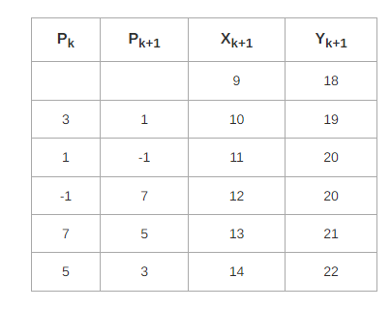
Similarly, Step-03 is executed until the end point is reached or number of iterations equals to 4 times. (Number of iterations = ΔX – 1 = 5 – 1 = 4)

Slide 15
Calculate the points between the starting coordinates (20, 10) and ending coordinates (30, 18).
Ex. Plot the line by Using Bresenham’s Line Generation Algo from (5,5) to (13,9).

Slide 16
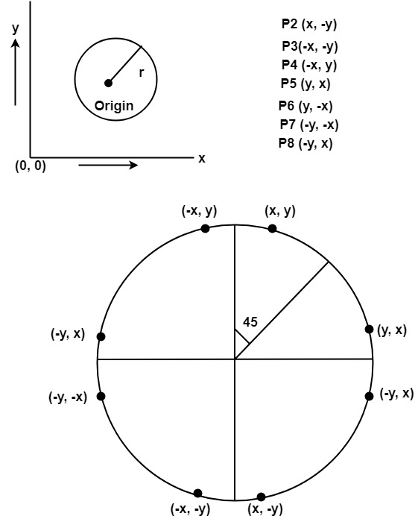
Circle Generation Algorithms :
Defining a Circle:
Circle is an eight-way symmetric figure. The shape of circle is the same in all quadrants. In each quadrant, there are two octants. If the calculation of the point of one octant is done, then the other seven points can be calculated easily by using the concept of eight-way symmetry. For drawing, circle considers it at the origin. If a point is P1(x, y), then the other seven points will be

Slide 17
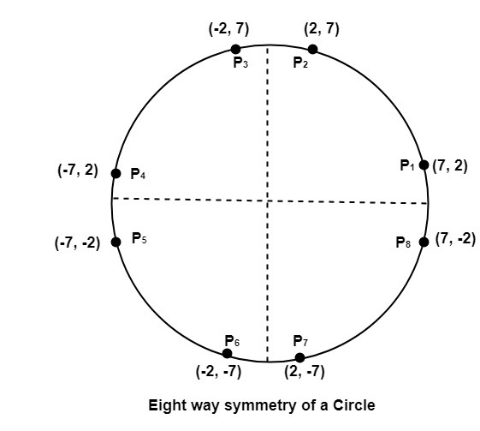
Let we determine a point (2, 7) of the circle then other points will be
(2, -7), (-2, -7), (-2, 7), (7, 2), (-7, 2), (-7, -2), (7, -2). These seven points are calculated
by using the property of reflection. The reflection is accomplished by reversing x, y co-ordinates.
If we want to display circle on
screen then the putpixel function is used
for eight points as :
putpixel (x, y, color) putpixel (x, -y, color) putpixel (-x, y, color) putpixel (-x, -y, color) putpixel (y, x, color) putpixel (y, -x, color) putpixel (-y, x, color) putpixel (-y, -x, color)

Slide 18

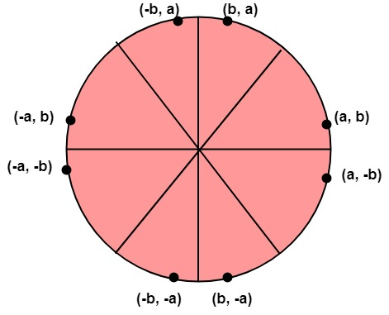
Circle Generation Algorithms :
1) Mid Point Circle Generation Algo.
2) Bresenham’s Circle Generation Algo.
1) Mid Point Circle Generation Algo. :
It is based on the following function for testing the spatial relationship between the arbitrary point (x, y) and a circle of radius r centered at the origin.

Slide 19
Algorithm:
If ‘r’ is the radius of the circle then to draw & origin is its center, then to do
plot first Octant of circle & the do following
Step1: Plot the initial point (Xi, Yi) and Put Xi =0, Yi =r
Step2: . Find the initial decision parameter
Pi=1-r
Step3: If we are octant symmetry to plot the pixel, then we perform the following steps
Until(X ≤ Y)
If (Pk<0) Then set Pk+1= Pk + 2x + 1 & Xi+1= Xi+k & Yi+1= Yi Else Pk+1 = Pk + 2(x-y)+1
Xi+1= Xi+k+1 Yi+1 =Yi - 1 Step4: End

Slide 20
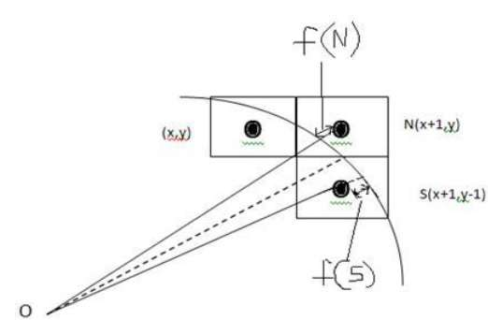
Bresenham’s Circle drawing Algorithm :
We cannot display a continuous arc on the raster display. Instead, we have to
choose the nearest pixel position to complete the arc.
you can see that we have put the pixel at X,Y location and now need to decide where to put the next pixel − at N X+1,Y or at S X+1,Y−1.
This can be decided by the decision parameter d.
If d <= 0, then N, X+1,Y is to be chosen as next pixel.
If d > 0, then S , X+1,Y−1 is to be chosen as the next pixel.

Slide 21
Algorithm :
Step 1 − Get the coordinates of the center of the circle and radius, and store them
in x, y, and r respectively. Set X=0 and Y=r.
Step 2 − Calculate the initial value of decision parameter
P = 3 – 2r.
Step 3 − If we are going using octant Symmetry property to plot the pixel then until
X ≤ Y we performing
If P0< 0 then
Pnew= Pold + 4x + 6.
and Xnew= Xold + 1 , Ynew= Yold
Else
Pnew= Pold + 4(X-Y) + 10.
and Xnew= Xold + 1 , Ynew= Yold-1
Step 4− Determine the symmetry points in each other octants also.
Step 5−Move each calculated position (x,y) on the circle path centered on (Xc,Yc) & Plot the coordinates value as X=X+Xc & Y=Y+Yc.

Slide 22

.

